Slide 1
New GSKY Client Software Apps
Exploring client apps other than TerriaMap
Copyright © 2019 by National Computational Infrastructure, Canberra, ACT, Australia. All Rights Reserved.
Author: Arapaut V. Sivaprasad.
Created on: 02 May, 2019

Slide 2
Objectives
Update on the External GSKY clients
Live demo of the following:
Google Earth Web Online
Google Earth Desktop
NASA WorldWind Online
Next: Potential GSKY Clients

Slide 3
Potential GSKY Clients
Application | Comments | GSKY
ArcGIS | Most widely used GIS software | Works on 4 out of 6 App veriants
QGIS | Widely used and VDI-integrated | Works on v3.4
AUSGIN | Australian Geoscience Information Network | Works on Production GSKY server
NASA World View (Web) | Not directly suitable for GSKY | No WMS layer addition facility
NASA World Wind (App) | Not directly suitable for GSKY | No WMS layer addition facility
NASA World Explorer (Web) | Powered by NASA World Wind | Works on Production GSKY server
NASA Web World Wind (Web) | Powered by NASA World Wind | Works on Production GSKY server Can build our own web apps.
Auscope | Parallel service to AusGIN | Works on Production GSKY server
Google Earth Desktop and Online | Very popular software | WMS facility does not work
Next: Google Earth

Slide 4

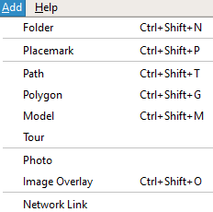
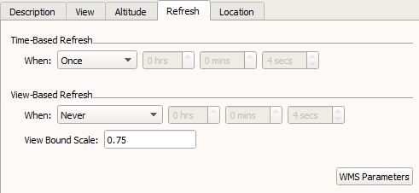
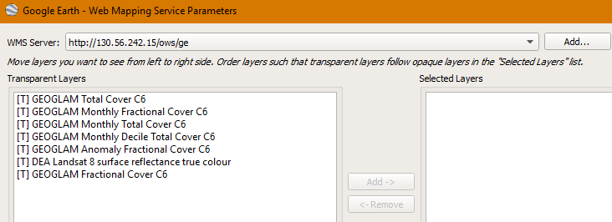
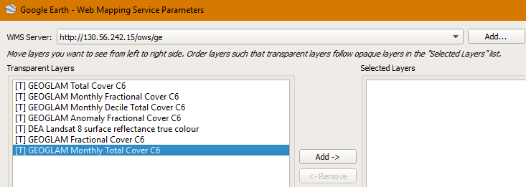
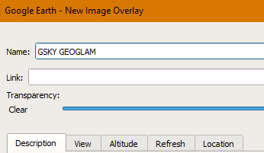
Google Earth Desktop
WMS – available but only supports v1.1.1
Results in Error fetching the Capabilities
Modified the ‘ows.go’ to send v1.1.1 Capabilities
Works fine.
GetMAP request in v1.1.1 is fine with GSKY
Adding GSKY Web Map Service

Slide 5
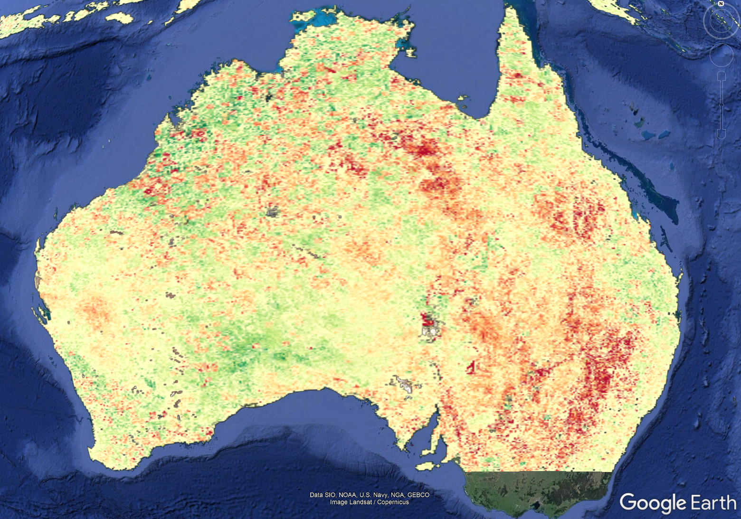
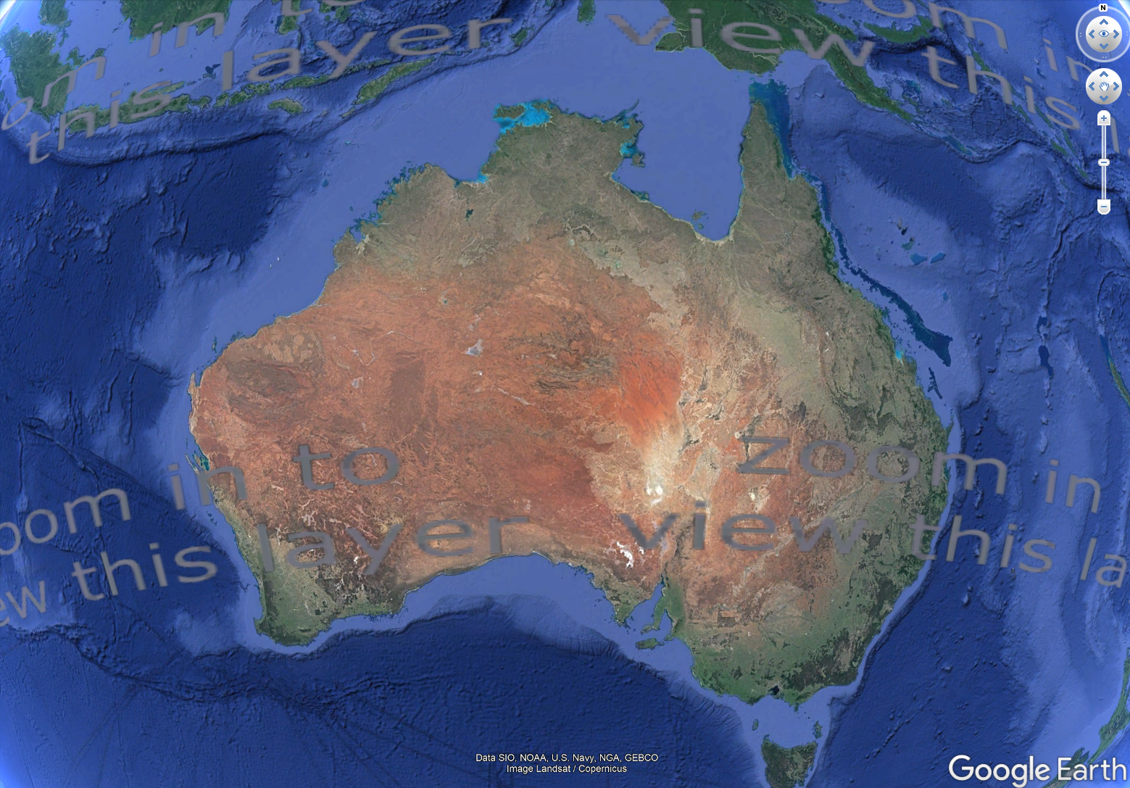
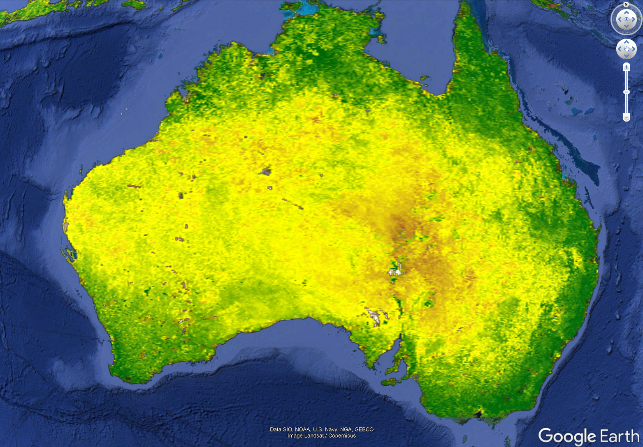
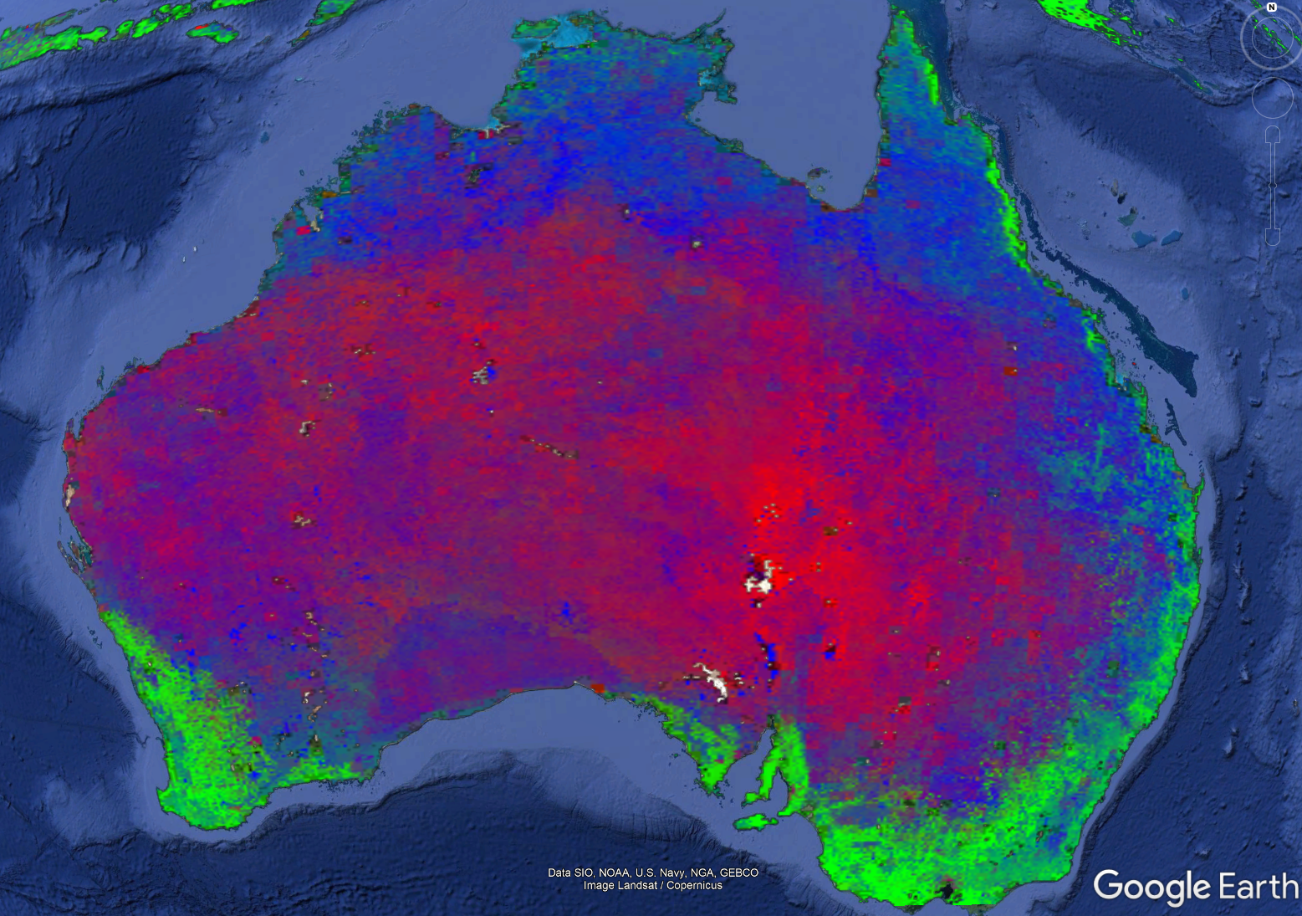
Google Earth Desktop

Slide 6






Acknowledgements

